Slide 1
Introduction to Python
Section 4
Chapter 1
© 2016 Pearson Education, Ltd. All rights reserved.

Slide 2

Starting IDLE
Windows:
Invoke with double click of
MAC:
Open Finder, select Applications, select the Utilities folder, select Terminal, and then enter IDLE at the prompt
LINUX and UNIX: usually be found at /usr/bin/idle3
© 2016 Pearson Education, Ltd. All rights reserved.

Slide 3
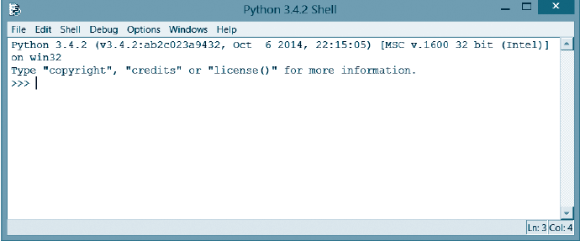
Starting IDLE
FIGURE 1.13 The Python shell.
© 2016 Pearson Education, Ltd. All rights reserved.

Slide 4
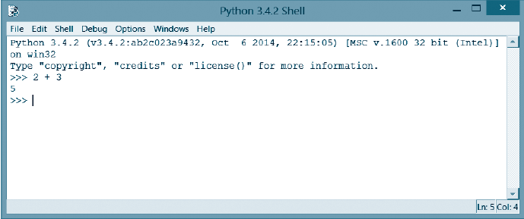
Starting IDLE
FIGURE 1.14 The Python shell after the
expression 2 + 3 has been evaluated.
© 2016 Pearson Education, Ltd. All rights reserved.

Slide 5
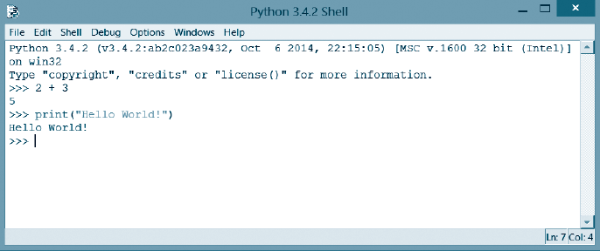
Starting IDLE
FIGURE 1.15 The Python shell after the
statement print("Hello World!") has been executed.
© 2016 Pearson Education, Ltd. All rights reserved.

Slide 6
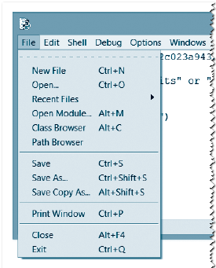
A Python Code Editor Walkthrough
FIGURE 1.16 The File drop-down list.
© 2016 Pearson Education, Ltd. All rights reserved.

Slide 7
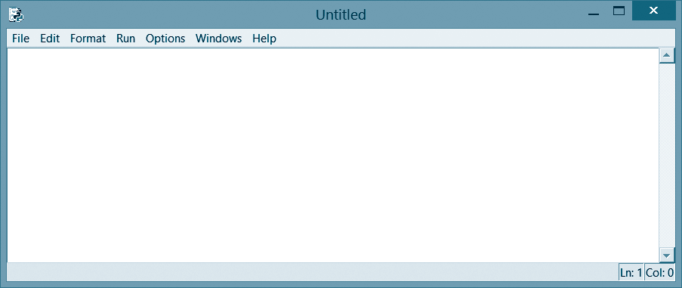
A Python Code Editor Walkthrough
FIGURE 1.17 The code editor window generated
after New Window is clicked on.
© 2016 Pearson Education, Ltd. All rights reserved.

Slide 8
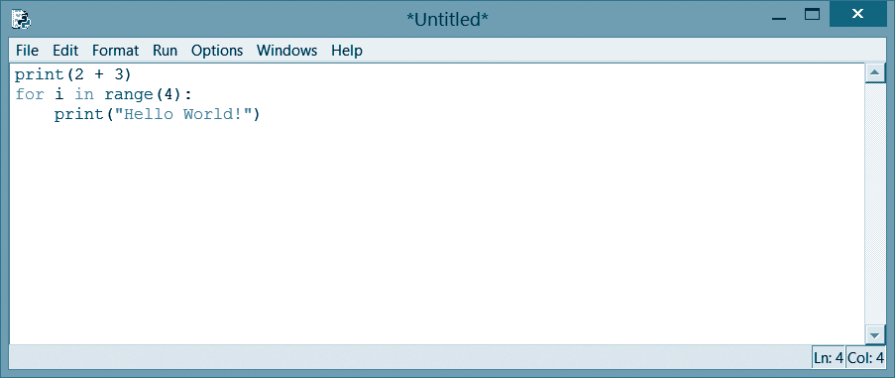
A Python Code Editor Walkthrough
FIGURE 1.18 The code editor window
containing a three-line Python program.
© 2016 Pearson Education, Ltd. All rights reserved.

Slide 9
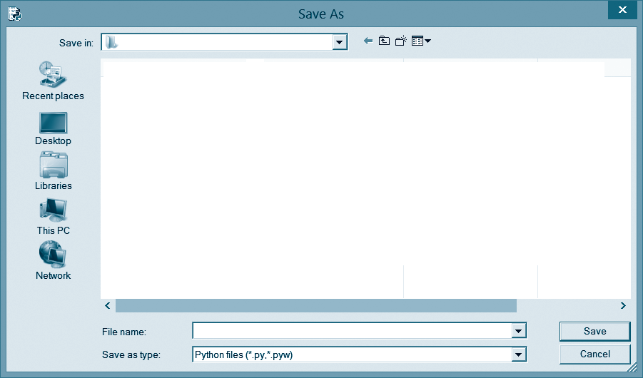
A Python Code Editor Walkthrough
FIGURE 1.19 A Save As dialog box.
© 2016 Pearson Education, Ltd. All rights reserved.

Slide 10
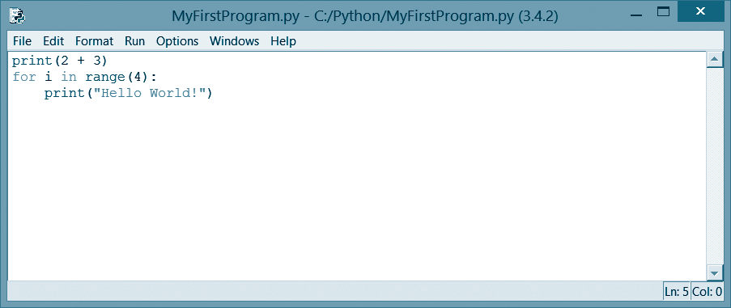
A Python Code Editor Walkthrough
FIGURE 1.20 The code editor window containing
a three-line Python program.
© 2016 Pearson Education, Ltd. All rights reserved.

Slide 11
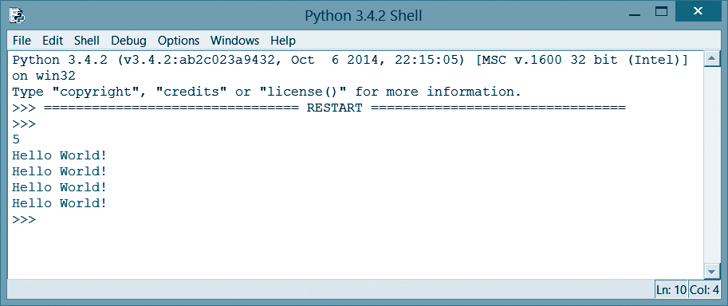
A Python Code Editor Walkthrough
FIGURE 1.21 Press the F5 key to execute.
© 2016 Pearson Education, Ltd. All rights reserved.

Slide 12
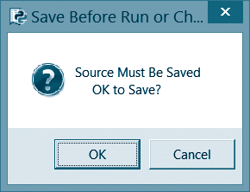
A Python Code Editor Walkthrough
FIGURE 1.22 A Save message box.
© 2016 Pearson Education, Ltd. All rights reserved.

Slide 13

An Open-a-Program Walkthrough
Click on desired program
FIGURE 1.23 An Open dialog box.
© 2016 Pearson Education, Ltd. All rights reserved.

Slide 14
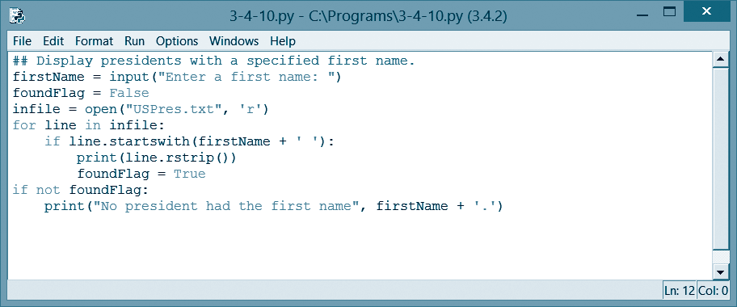
An Open-a-Program Walkthrough
FIGURE 1.24 Example 10 of Section 3.4.
© 2016 Pearson Education, Ltd. All rights reserved.

Slide 15
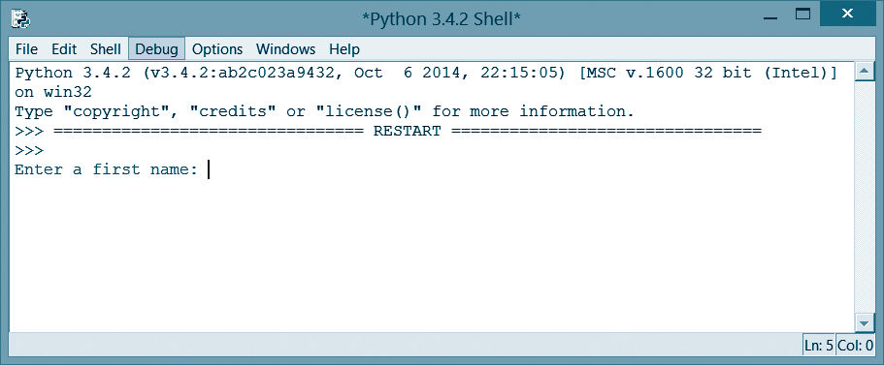
An Open-a-Program Walkthrough
FIGURE 1.25 Request for input from Example 10 of Section 3.4.
© 2016 Pearson Education, Ltd. All rights reserved.

Slide 16
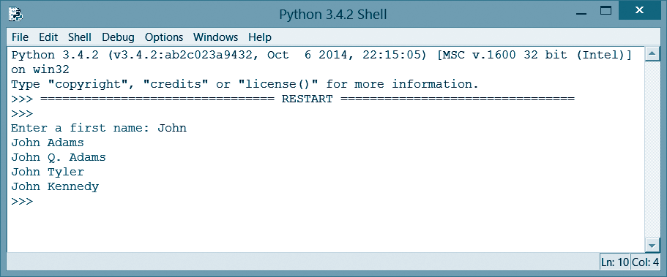
An Open-a-Program Walkthrough
FIGURE 1.26 Complete output for Example 10 of Section 3.4.
© 2016 Pearson Education, Ltd. All rights reserved.

Slide 17
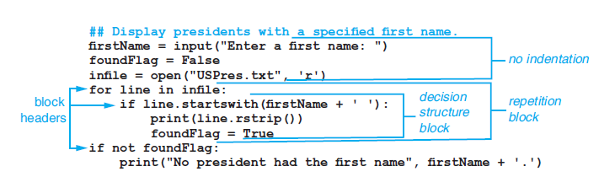
Block-Structure
Figure 1.27 Example 10 of Section 3.4.
© 2016 Pearson Education, Ltd. All rights reserved.

Slide 18
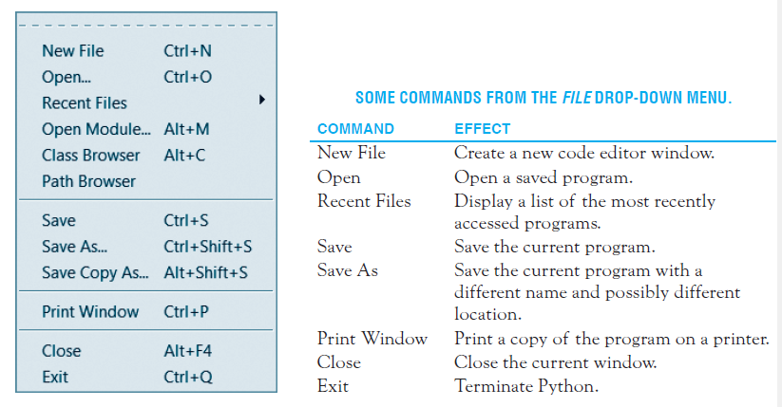
The File Drop-down Menu
FIGURE 1.28 The File drop-down menu.
© 2016 Pearson Education, Ltd. All rights reserved.

Slide 19
End
Section 4
Chapter 1
© 2016 Pearson Education, Ltd. All rights reserved.

